Slide 1

Deepfake Video Detection
Group Members:
Muneeb Raza(17P-6149)
Saood Ur Rahman(17P-6092)
Supervisor: Ms. Safia Fatima
1

Slide 2
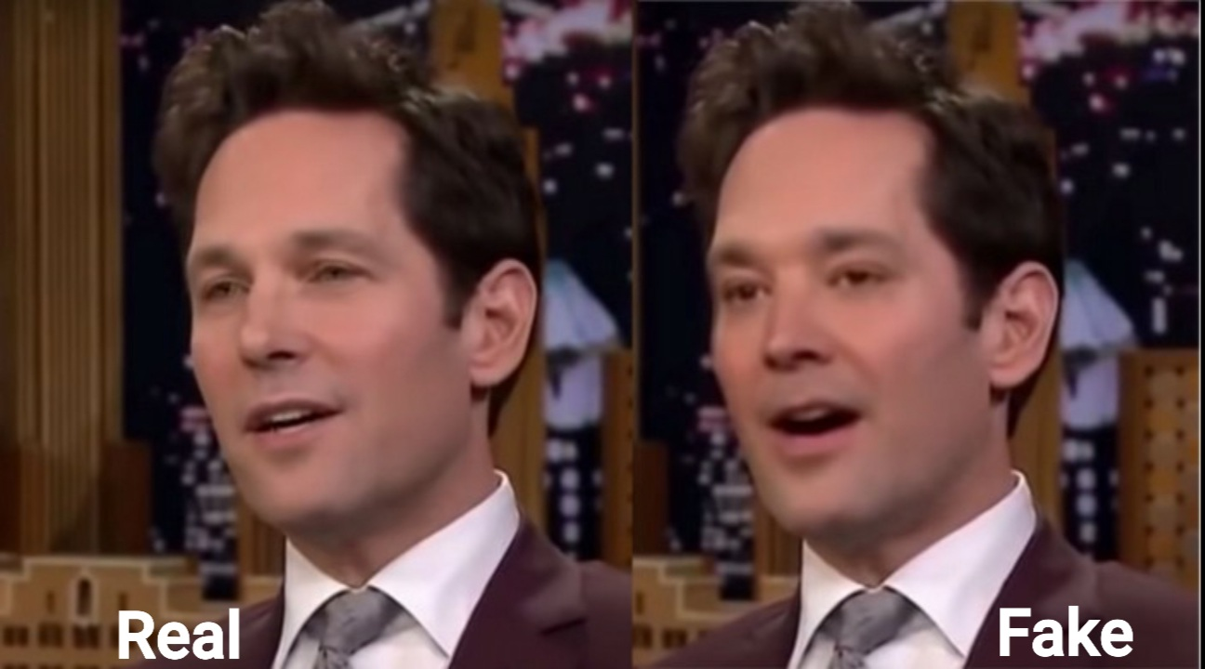
Introduction
What is a Deepfake?
A video manipulation technique which generates and replaces faces
Utilizes neural network
First deepfake video emerged in 2017
Positive Use:
Updating episodes of movies without reshooting them
where is deepfake today:
DeepNude Software
Chinese app Zao
Etc.
2

Slide 3
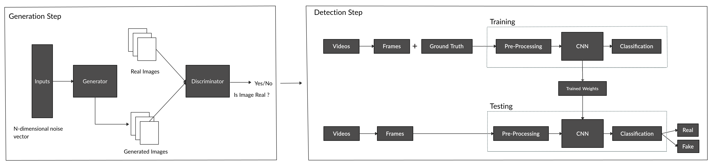
Architecture Diagram
3

Slide 4

GANs Mathematics
$${}_{G}^{min}{ {}_{D}^{max}{ V\left(D, G\right)= 𝔼_{x\sim p_{data}\left(x\right) }\left[\log{D\left(x\right)}\right]+𝔼_{z\sim p_{z}\left(z\right)}\left[\log\left(1−D\left(G\left(z\right)\right)\right)\right]} }$$
$D$ is the Discriminator.
$G$ is the Generator.
$x$ is come from the training data.
$z$ is the input noise.
$V$ is the value function.
Ian Goodfellow, Jean Pouget-Abadie, Mehdi Mirza, Bing Xu, David Warde-Farley, Sherjil Ozair, Aaron Courville, Yoshua Bengio, Generative Adversarial Nets
4

Slide 5

Algorithm for GAN
for number of training iterations do
for k steps do
•Sample$m$noise samples $\left\{z^{\left(1\right)},…,z^{\left(m\right)}\right\}$ and transform with Generator
•Sample $m$ real samples $\left\{x^{\left(1\right)},…,x^{\left(m\right)}\right\}$ from real data
•Update the discriminator by ascending its stochastic gradient:
$$∇_{θ_{d}}\frac{1}{m}\sum_{i=1}^{m}{\left[\log{D\left(x^{\left(i\right)}\right)+\log\left(1−D\left(G\left(z^{\left(i\right)}\right)\right)\right)}\right]}$$
end for
•Sample m noise samples $\left\{z^{\left(1\right)},…,z^{\left(m\right)}\right\}$ and transform with Generator
•Update the generator by descending its stochastic gradient:
$$∇_{θ_{g}}\frac{1}{m}\sum_{i=1}^{m}{\log\left(1−D\left(G\left(z^{\left(i\right)}\right)\right)\right)}$$
end for
Ian Goodfellow, Jean Pouget-Abadie, Mehdi Mirza, Bing Xu, David Warde-Farley, Sherjil Ozair, Aaron Courville, Yoshua Bengio, Generative Adversarial Nets
5

Slide 6
DCGAN
Very similar to GANs
Using deep convolutional network in place of fully connected network used in generic GANs..
More suitable to application with images/videos.
6

Slide 7
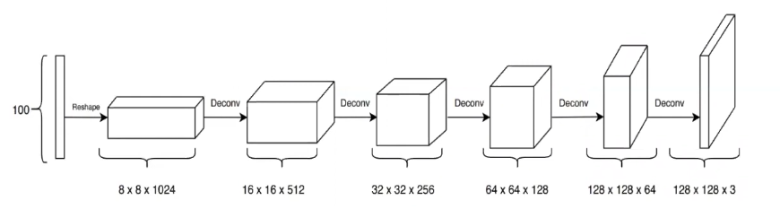
Generator Network
7

Slide 8
Generator
Noise vector of size of 100 was passed to the Generator.
Generator converts this noise into an image of (128, 128, 3) size.
Transpose convolution was used in this process.
Instead of the last layer, Batch normalization layers are used after the transpose convolution layer.
After batch normalization layers, LeakyReLu activation function is used.
Final image is passed through a tanh activation to squash the pixel range between (-1, 1).
8

Slide 9
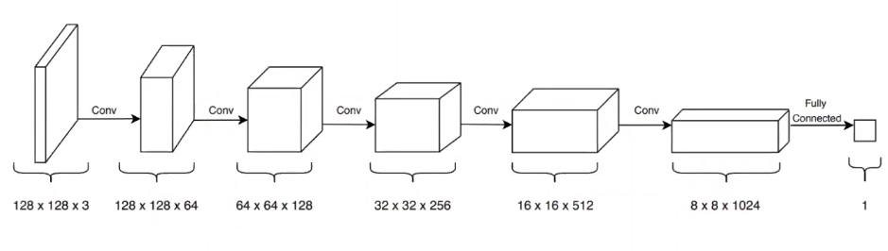
Discriminator Network
9

Slide 10
Discriminator
Tensor of images is passed with the shape(128, 128, 3) to the discriminator.
Discriminator gives a single output indicating whether this image is real or fake.
The final output is passed through sigmoid activation, which squashes the output between (0, 1).
If the out is close to 1, discriminator identifies the image as a real image and if the output is close to 0, the image is identified as a fake image.
10

Slide 11
Hyper-parameters
Epoch
Batch Size
Learning Rate
11

Slide 12
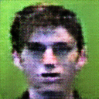
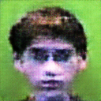
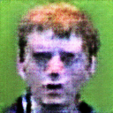
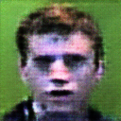
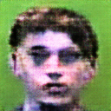
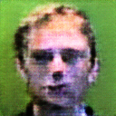
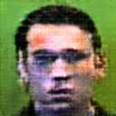
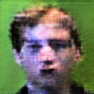
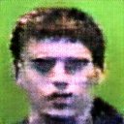
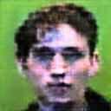
Results
12

Slide 13
Frechet Inception Distance
FID is a better measurement for image diversity.
FID is computed distance between real and fake images.
FID is 250 of these generated images.
13

Slide 14
Future Plan
FYP 2
Model implement
Training and tuning
Application
Documentation

Slide 15
Thank You
15

